Slide 1



Predicting Solar Power Output Using Linear Regression

Slide 2

Learning Objectives
The objective of this presentation is to understand how linear regression can be used to predict solar power output based on historical weather and environmental data. By the end of this discussion, participants will be able to grasp the key concepts of predictive modeling, understand the significance of data preprocessing, and explore the advantages of using linear regression in renewable energy forecasting. Additionally, it aims to highlight the importance of optimizing energy resources through accurate predictions.
GOAL
Source :
www.freepik.com/

Slide 3
Tools and Technology used
To develop the predictive model, Python is used as the programming language along with essential libraries such as NumPy and Pandas for data manipulation, Seaborn for exploratory data analysis, Scikit-learn for building and training the linear regression model, and Matplotlib for data visualization. The dataset consists of real-world solar power output data with environmental parameters. Jupyter Notebook or Google Colab is used as the development environment to perform model training and evaluation.

Slide 4
Methodology
The methodology for predicting solar power output using linear regression follows these steps: First, the dataset is loaded using Pandas, which contains solar power generation records, including weather conditions such as sunlight hours, temperature, and humidity. Exploratory Data Analysis (EDA) is then conducted using Seaborn to visualize patterns and correlations between variables. Data preprocessing is performed to handle missing values and normalize data for better model performance. Feature selection is carried out to identify the most significant predictors affecting power output. A Linear Regression model is trained using the processed dataset, and its performance is evaluated using metrics such as RMSE and R-squared. Finally, the model is tested on unseen data to predict future power output, providing insights into solar energy generation trends.

Slide 5
Problem Statement
Solar power generation is highly unpredictable as it depends on weather conditions such as sunlight, temperature, and humidity. The challenge lies in accurately forecasting power output to ensure efficient energy utilization and grid stability. Inconsistent power generation can lead to energy wastage and reliability concerns for power grids. Therefore, a robust predictive model is needed to analyze historical data and generate accurate future predictions to optimize solar energy usage.

Slide 6
Solution
The predictive model follows a supervised learning approach where historical data is analyzed to identify patterns in solar power generation. The independent variables such as temperature and radiation are used to estimate power output. Linear regression is used due to its simplicity and effectiveness in modeling relationships between continuous variables. To improve accuracy, techniques such as feature engineering, cross-validation, and hyperparameter tuning are applied. The developed model enables energy planners to make data-driven decisions for optimizing solar energy production.

Slide 7
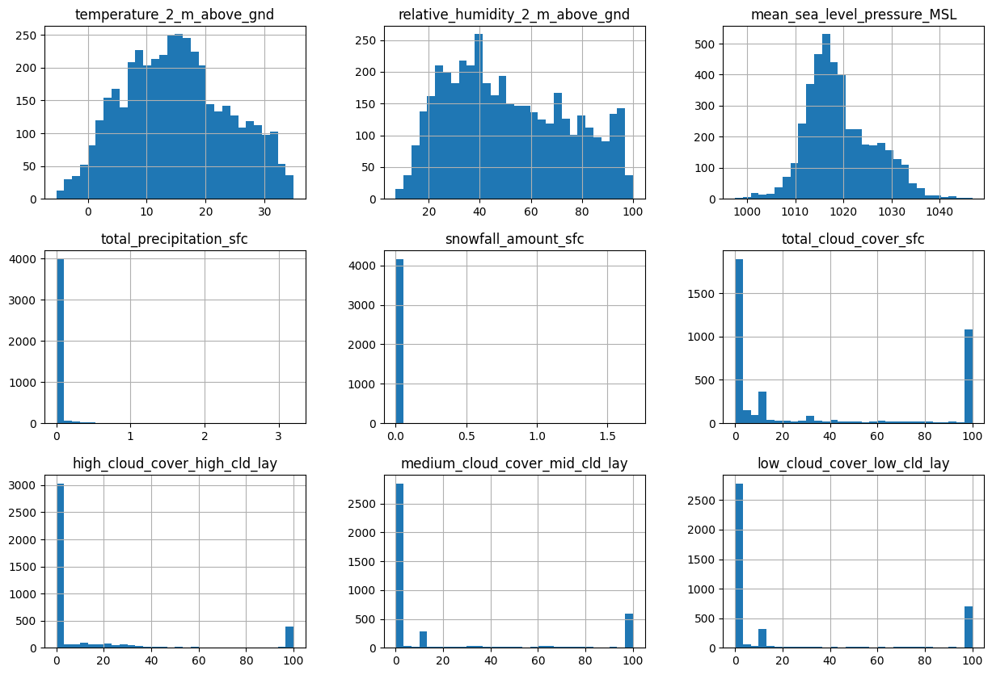
Screenshot of Output:
Feature Distribution Analysis Using Histograms

Slide 8
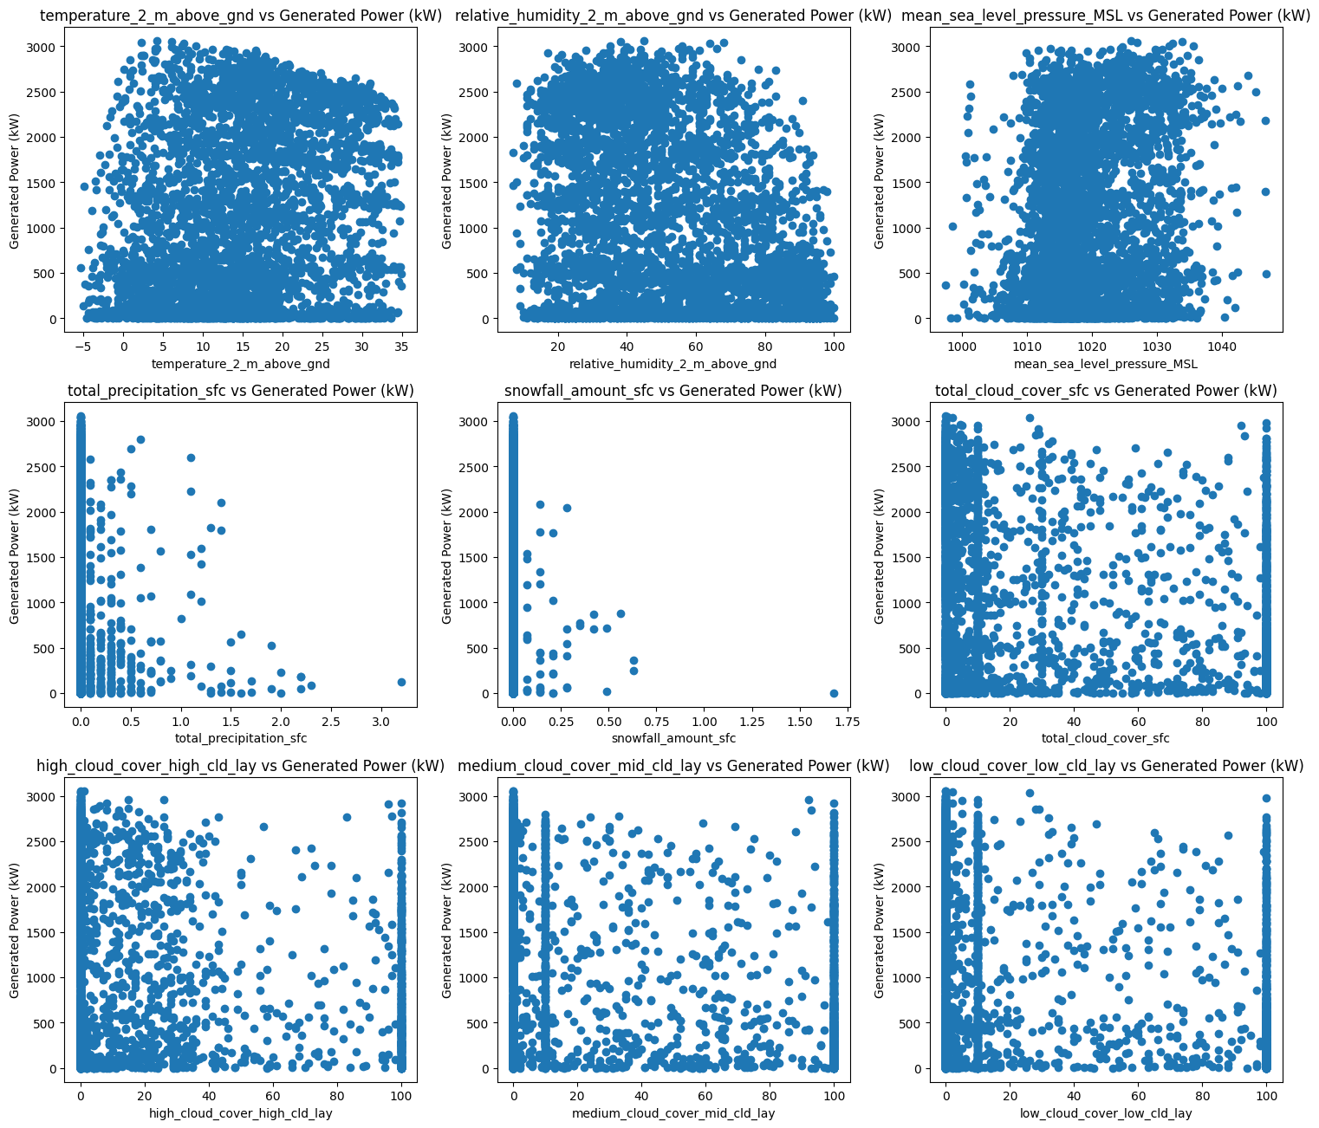
Scatter Plots: Feature Relationships with Generated Power (kW)

Slide 9
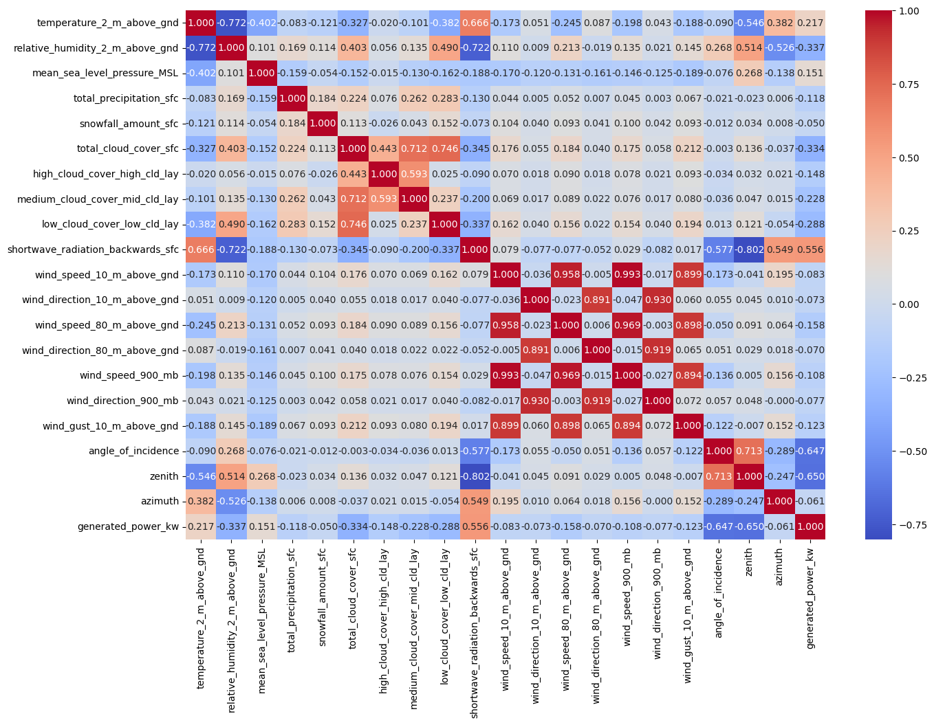
Correlation Heatmap of Features and Generated Power (kW)

Slide 10
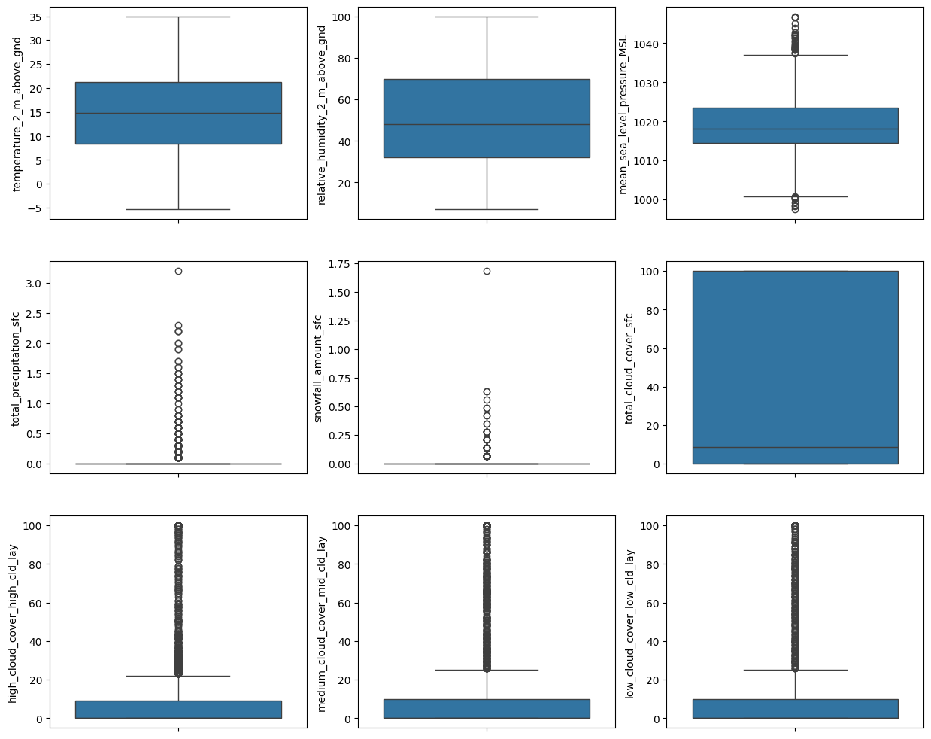
Box Plot Distribution of Dataset Features

Slide 11
Conclusion:
The machine learning model developed for predicting solar power output demonstrates consistent performance across both the training and test sets, with a Mean Absolute Error (MAE) of approximately 392 kW. The close values of MAE for training (392.42 kW) and testing (391.79 kW) indicate that the model generalizes well without overfitting, effectively capturing the relationship between meteorological features and power generation. This approach can be valuable for optimizing solar energy utilization, aiding in efficient power management, and supporting renewable energy integration into the grid. By leveraging predictive analytics, energy providers can better plan power supply, reduce dependency on non-renewable sources, and contribute to a more sustainable and efficient energy management system.

